Slide 1


School Advisory Council Meeting
September 20, 2023

Slide 2
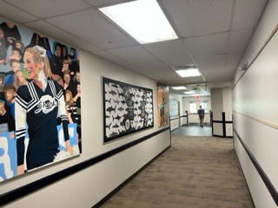
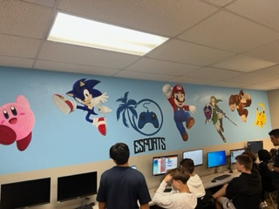
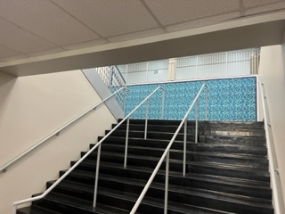
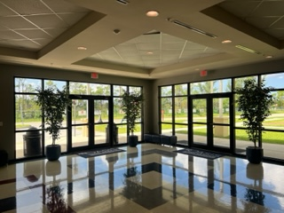
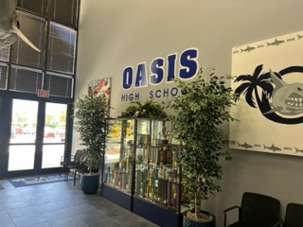
What’s been happening?
Building

Slide 3
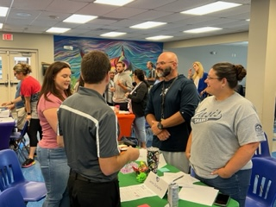
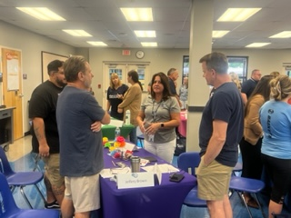
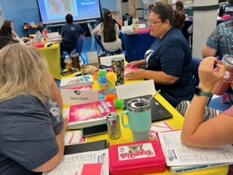
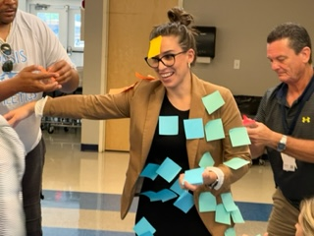
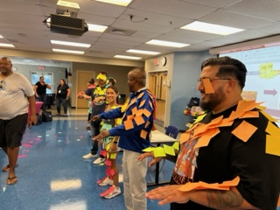
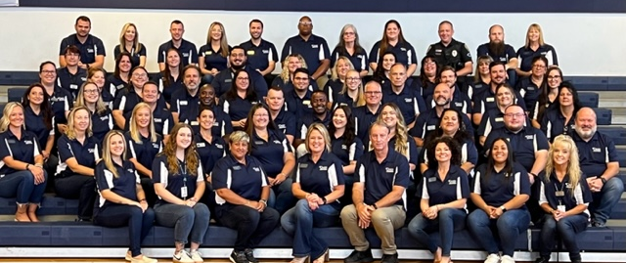
Staff Training

Slide 4
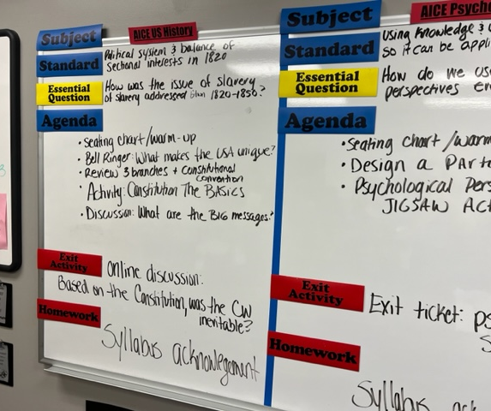
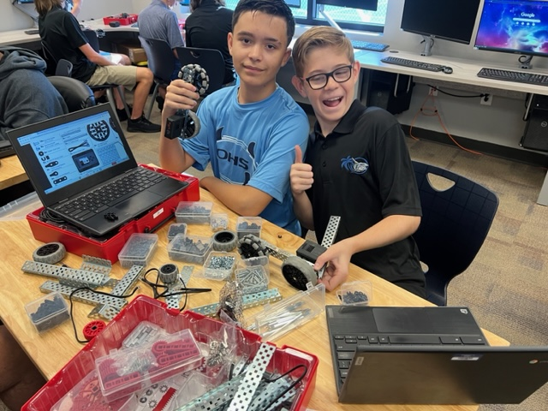
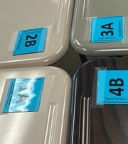
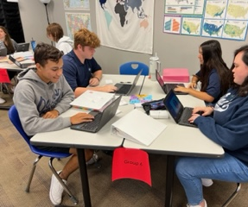

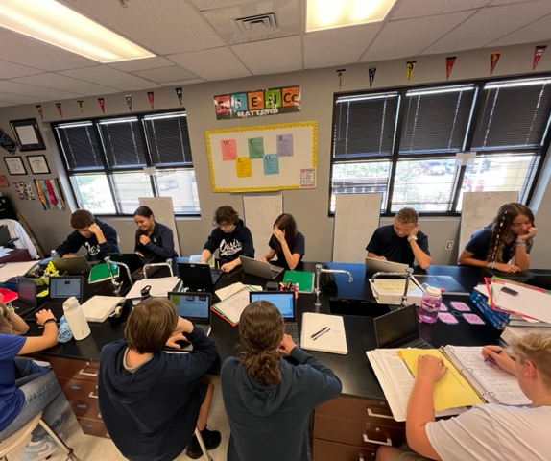
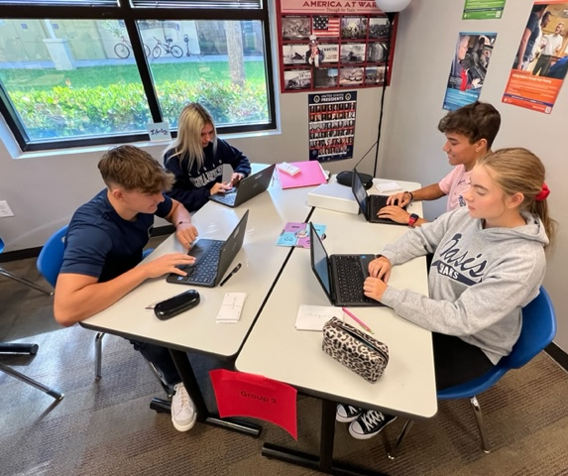

Slide 5
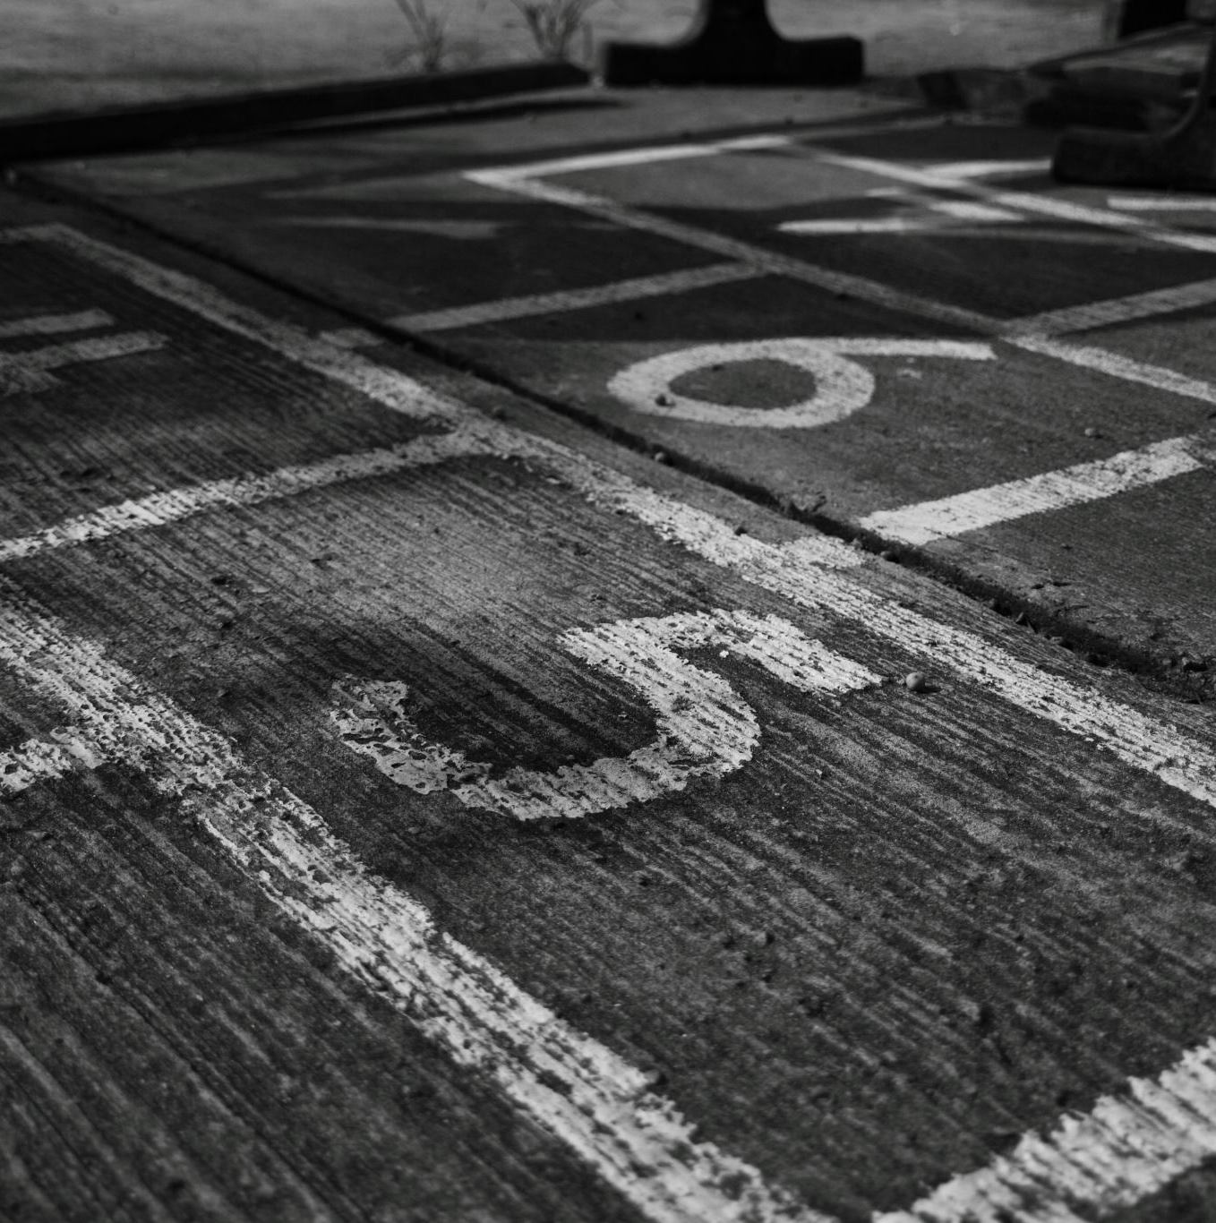
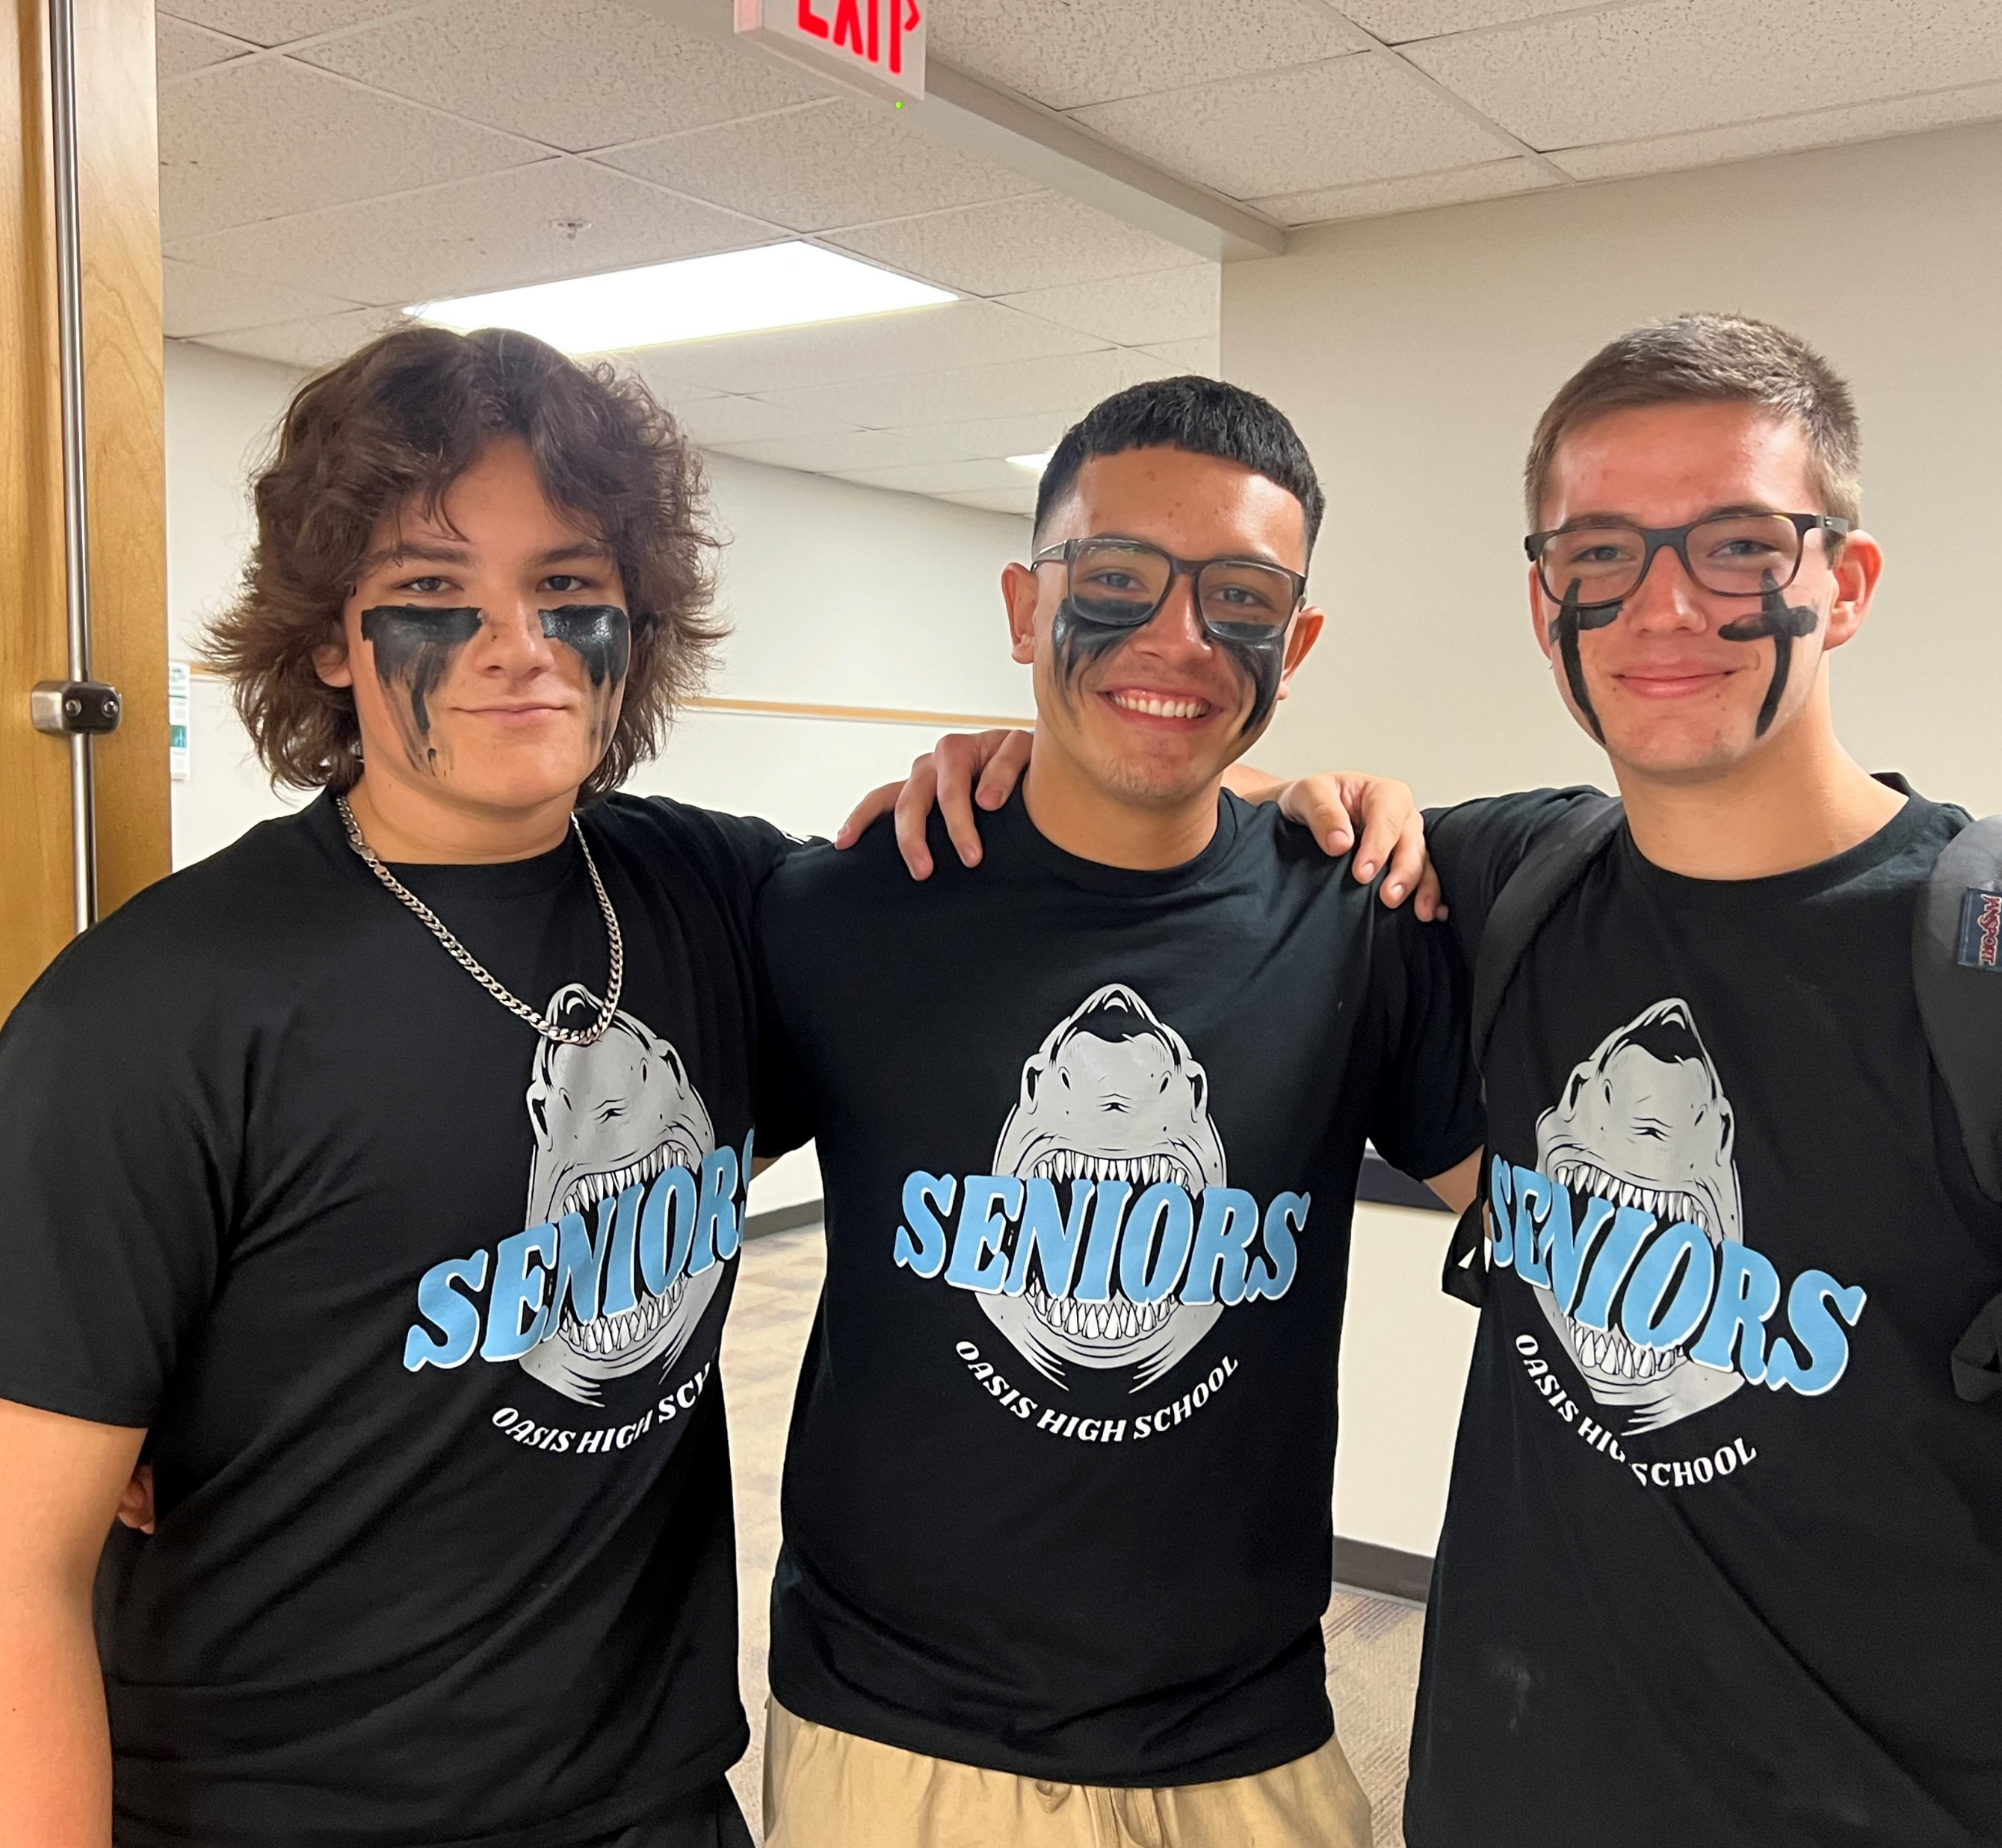
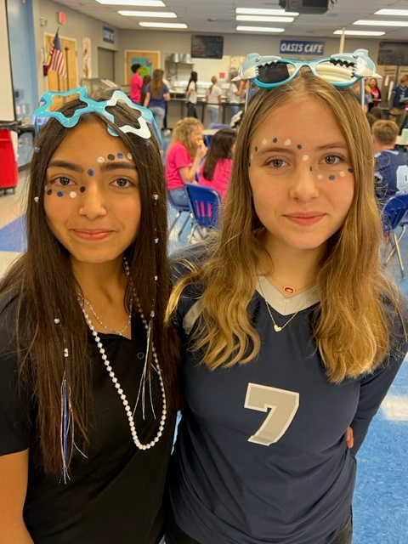
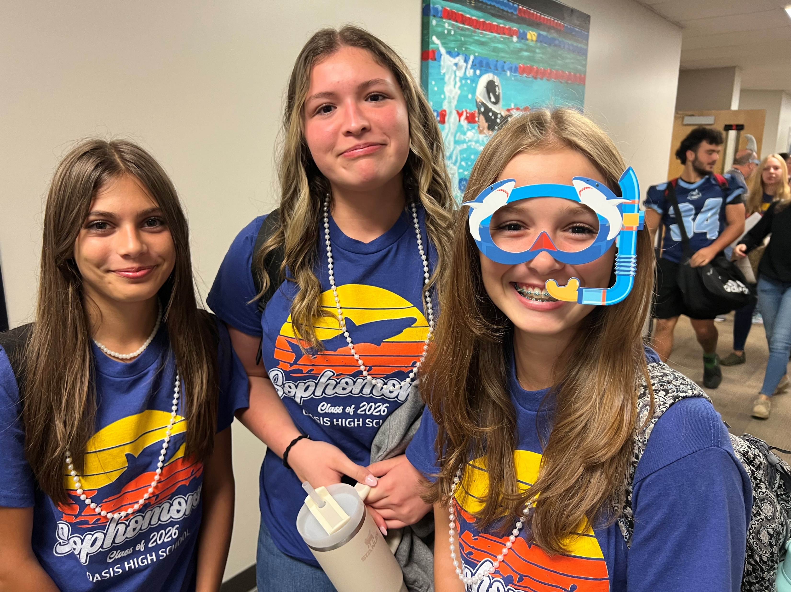
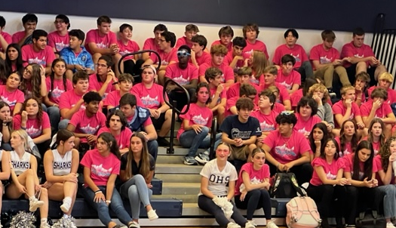
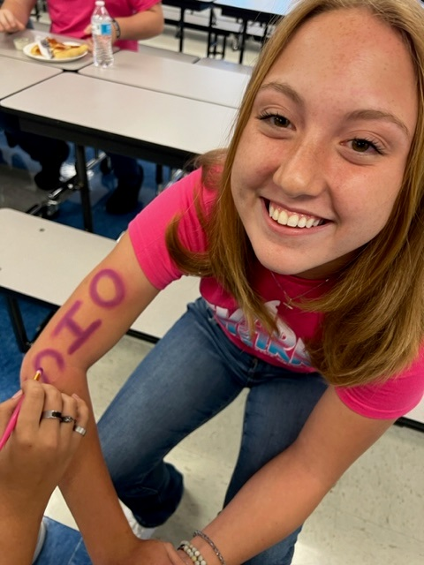
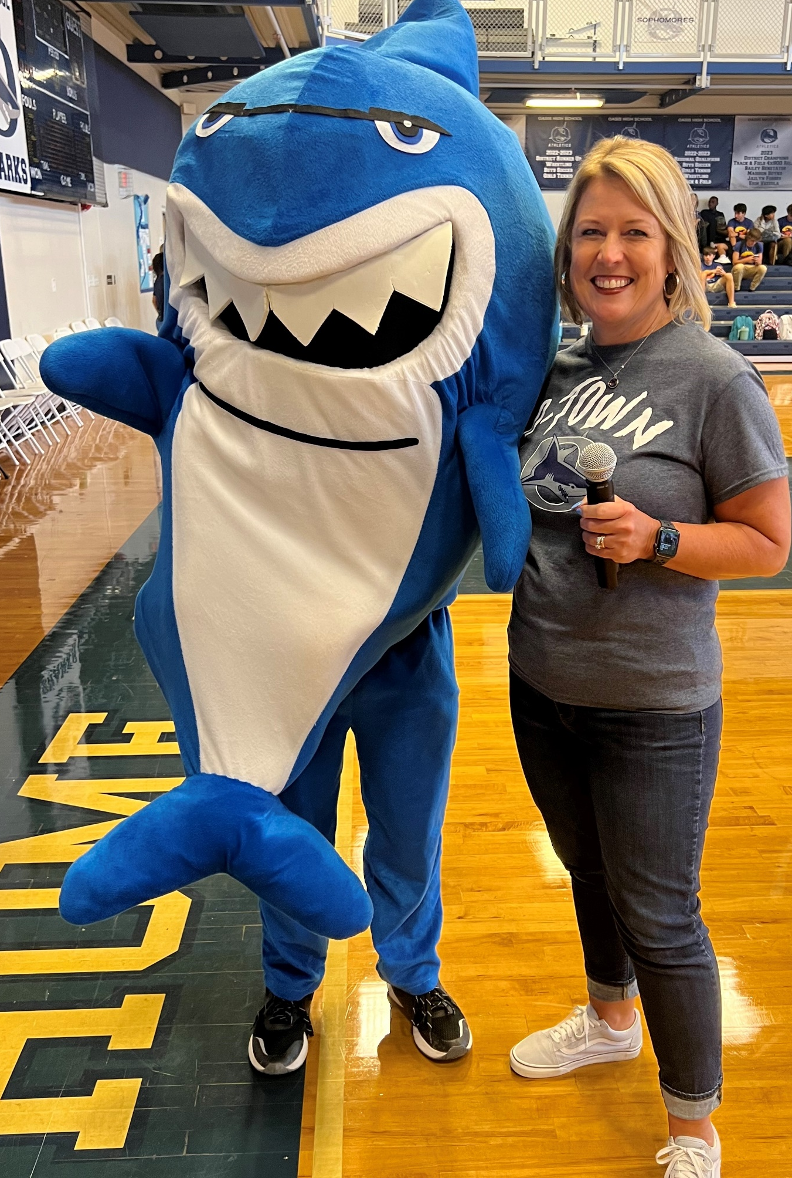
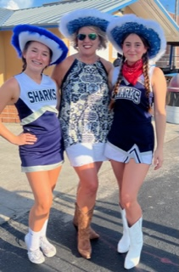
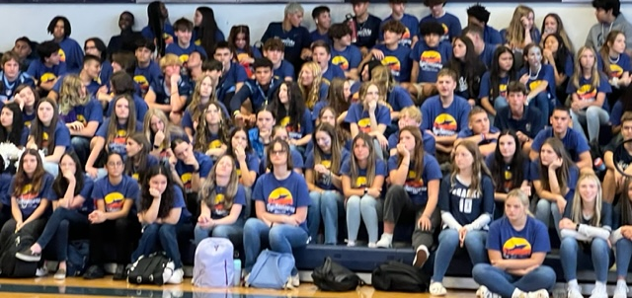
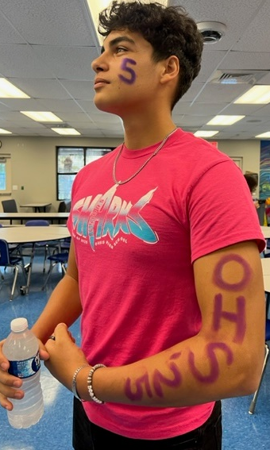
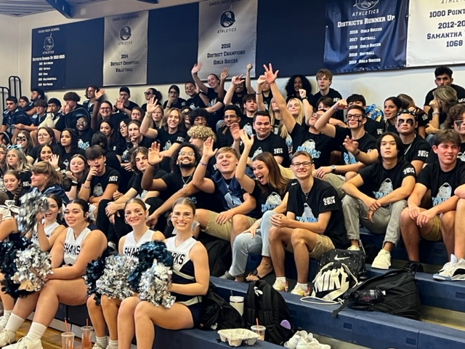
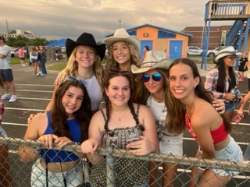
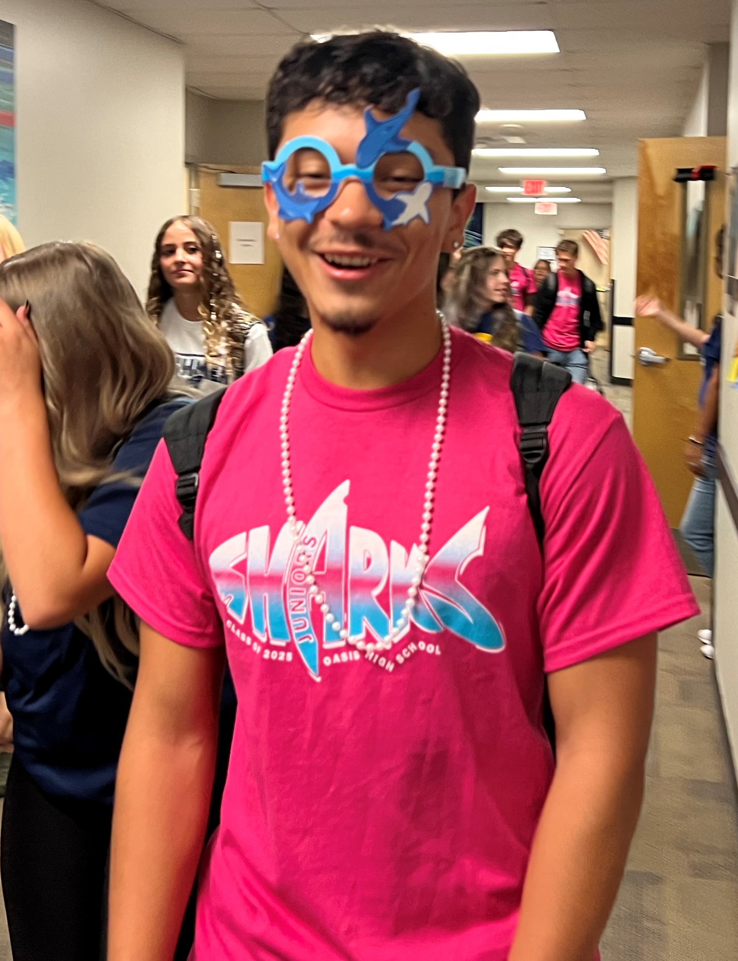
Positive Culture
Pep Rallies

Slide 6
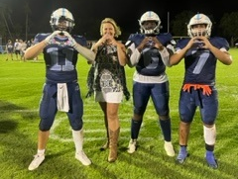
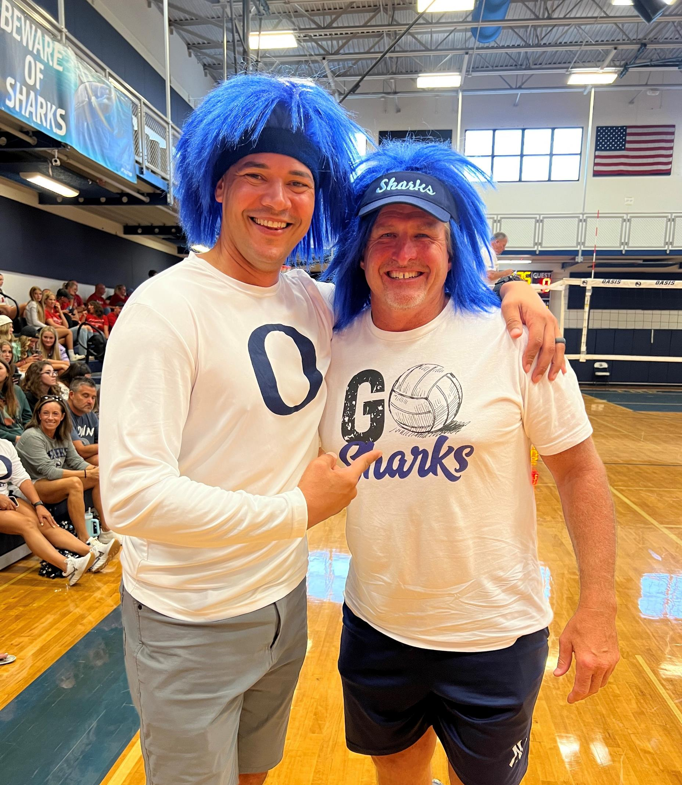
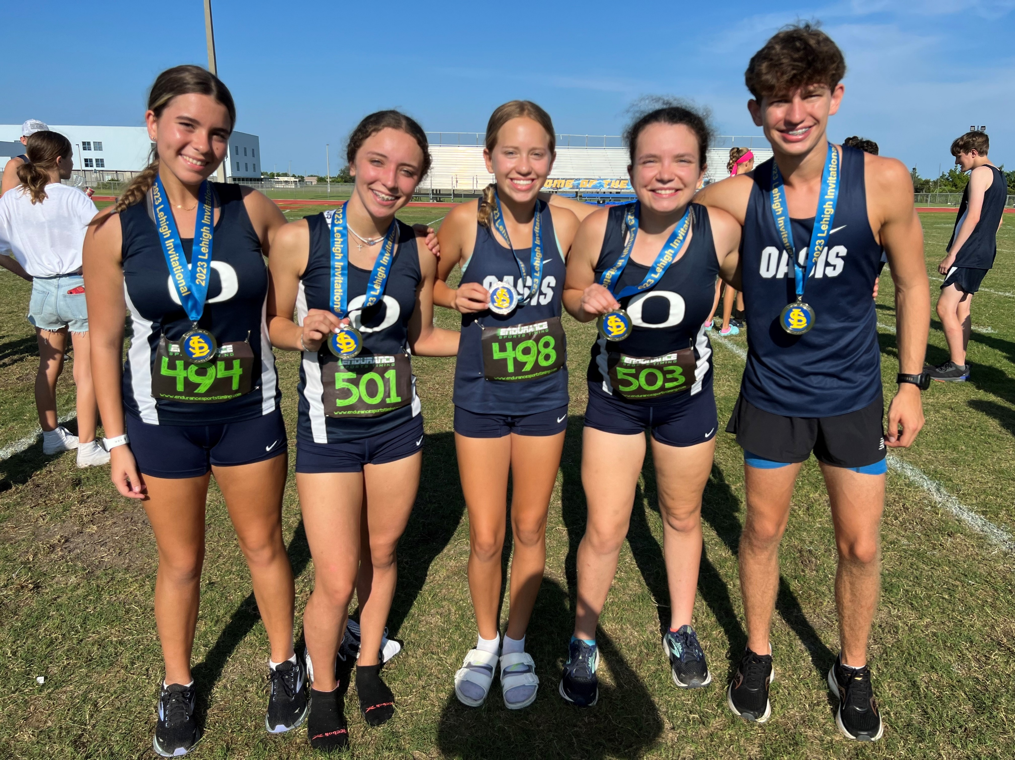
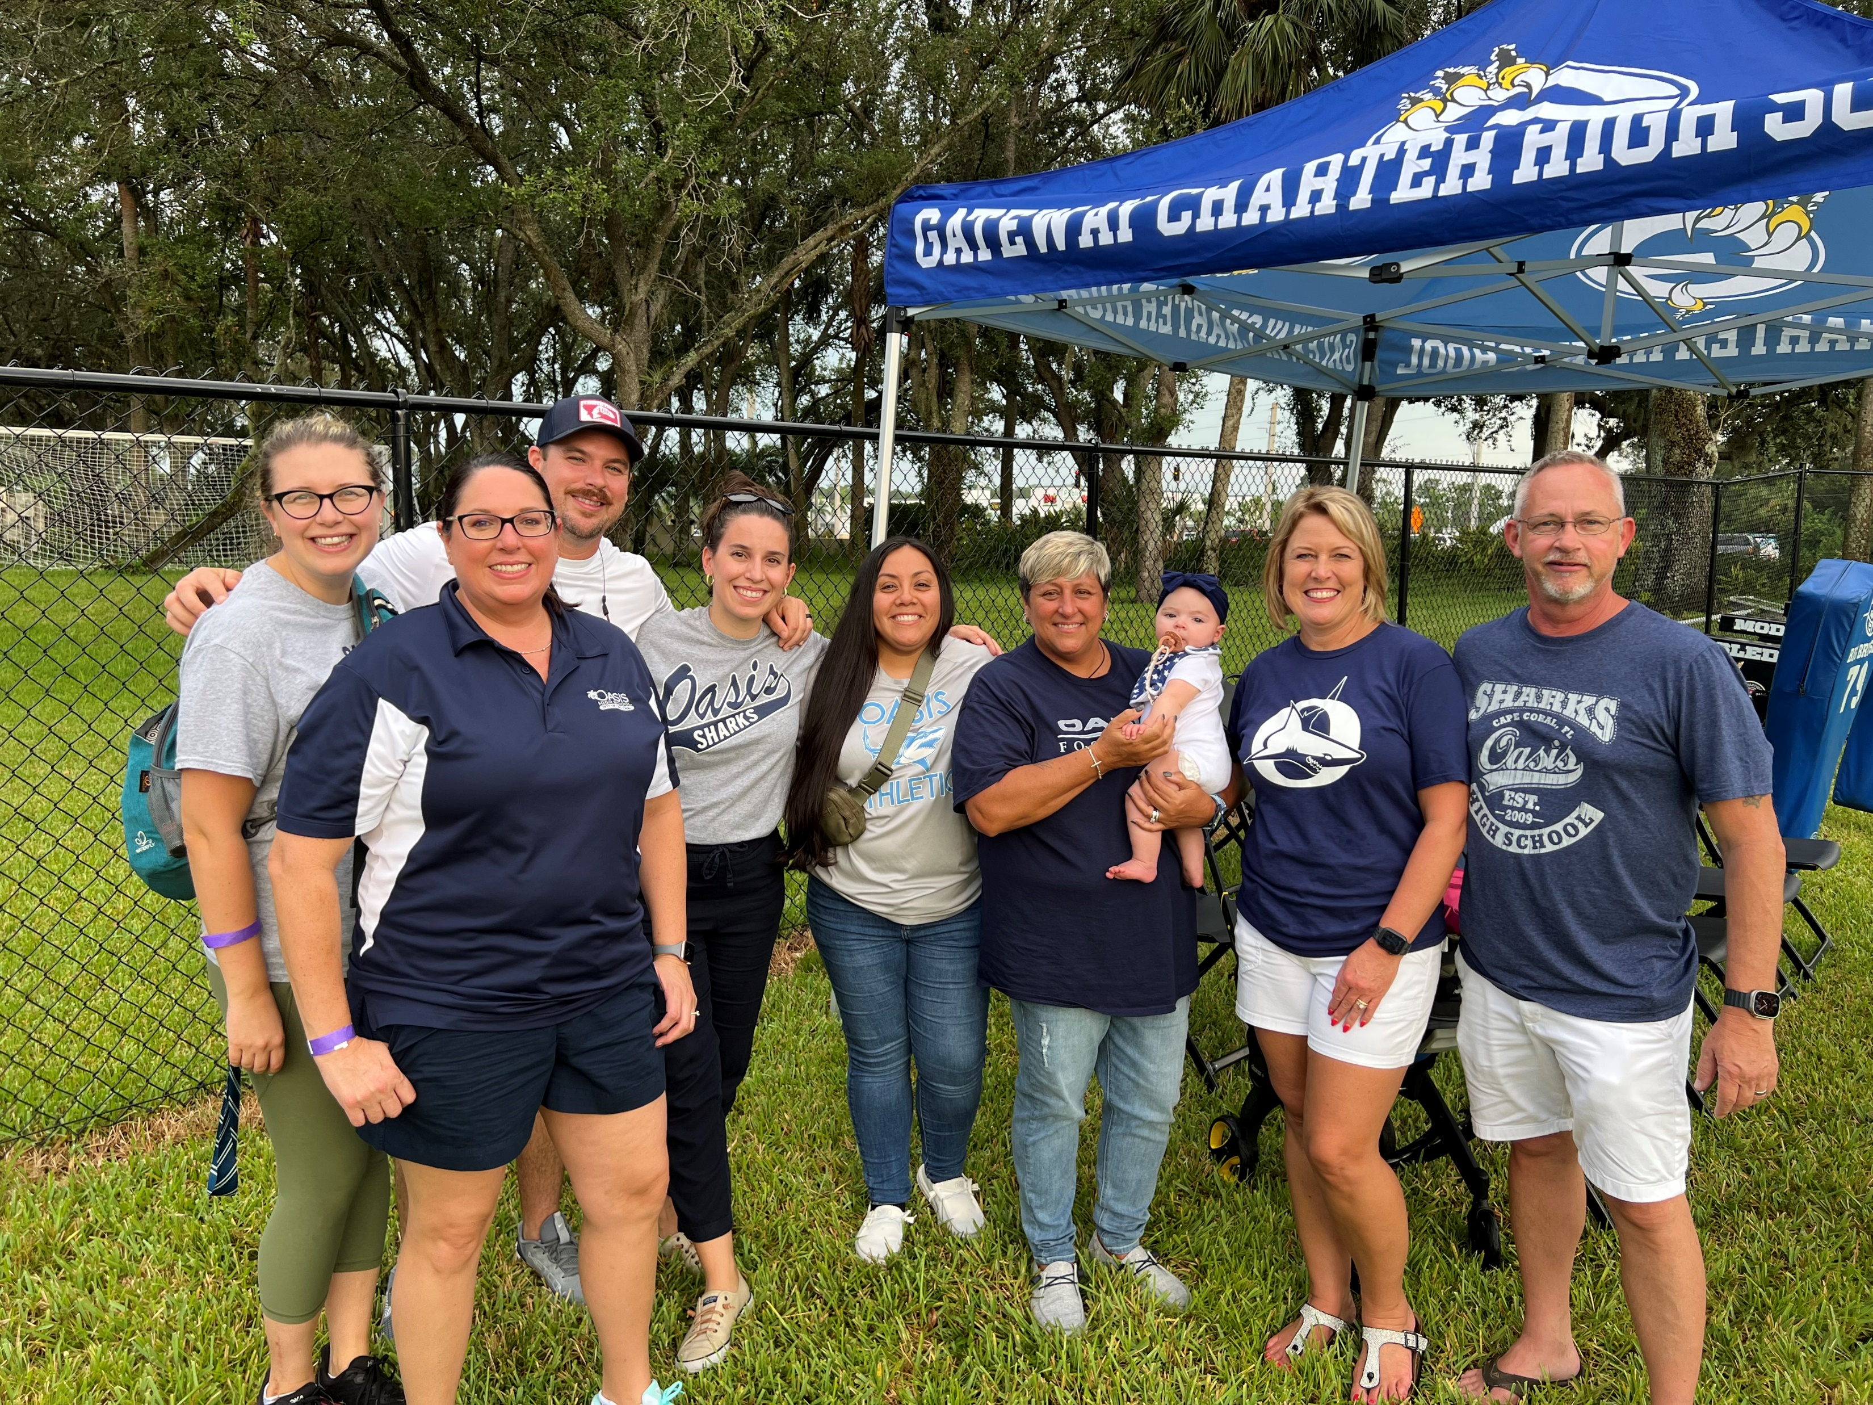
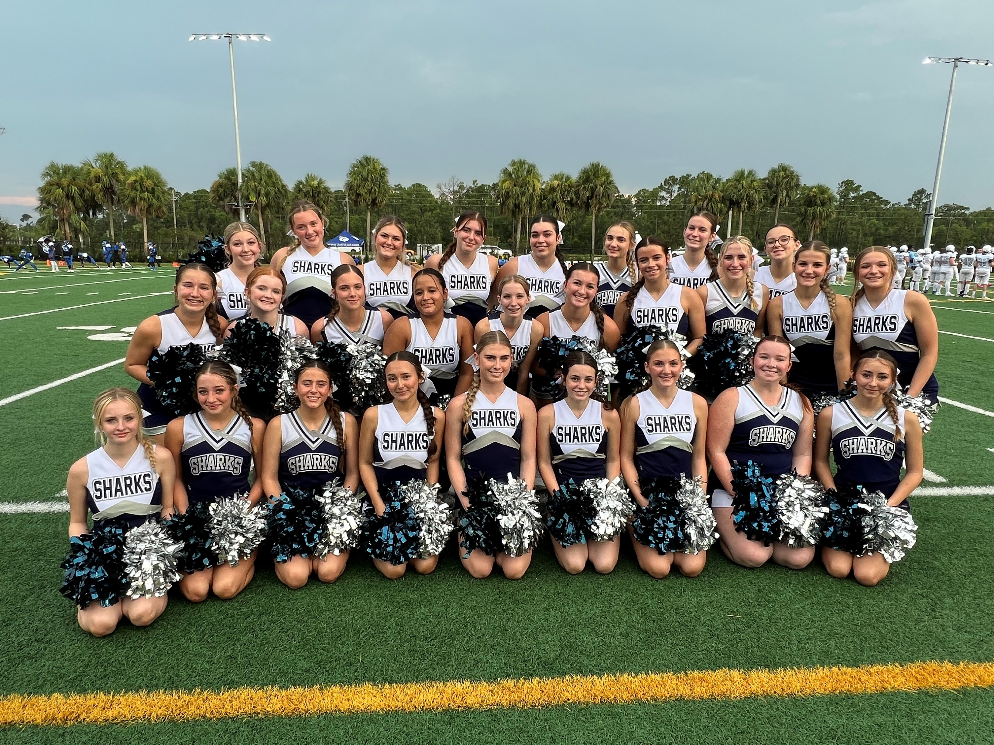
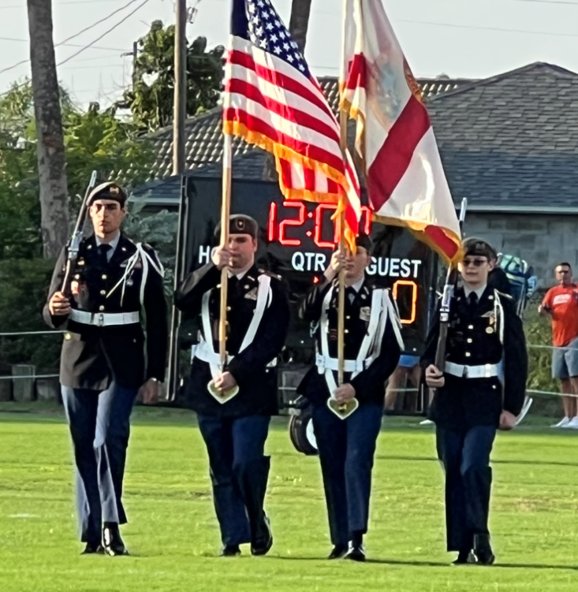
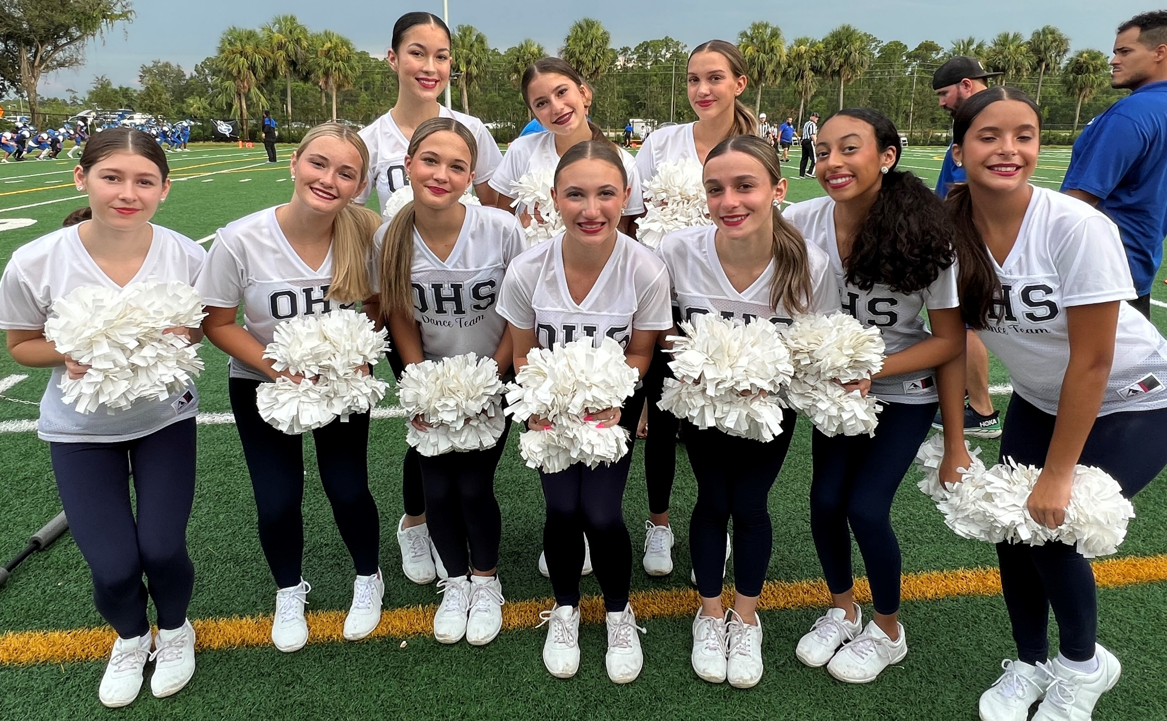
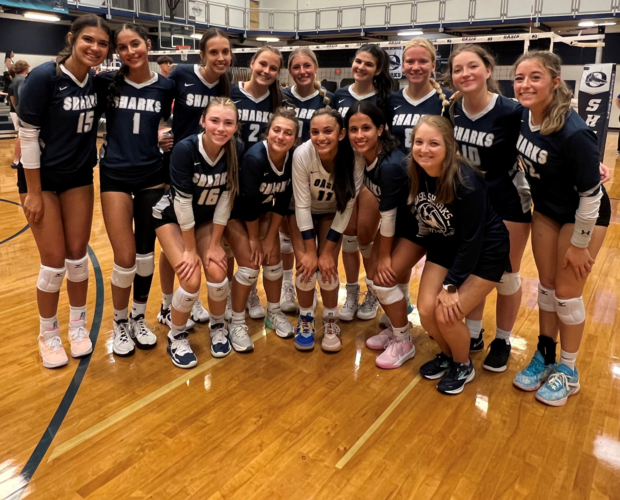
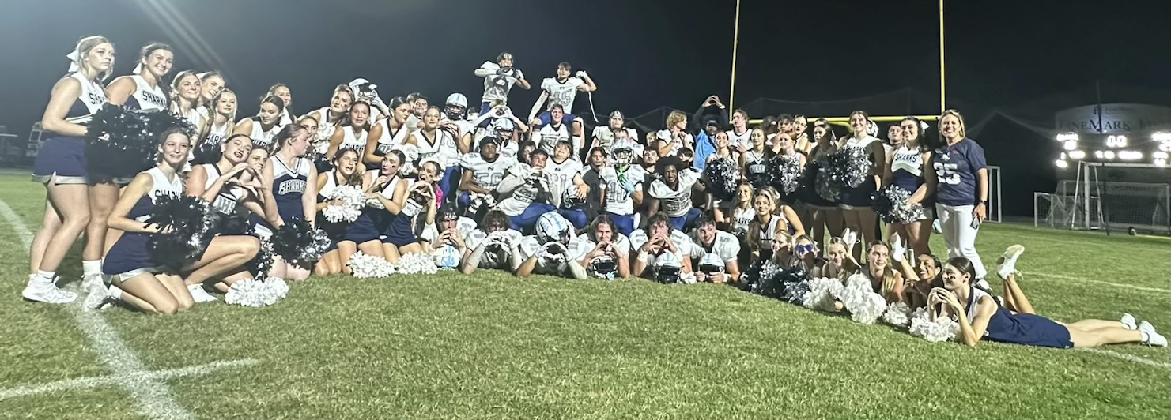
Athletics

Slide 7
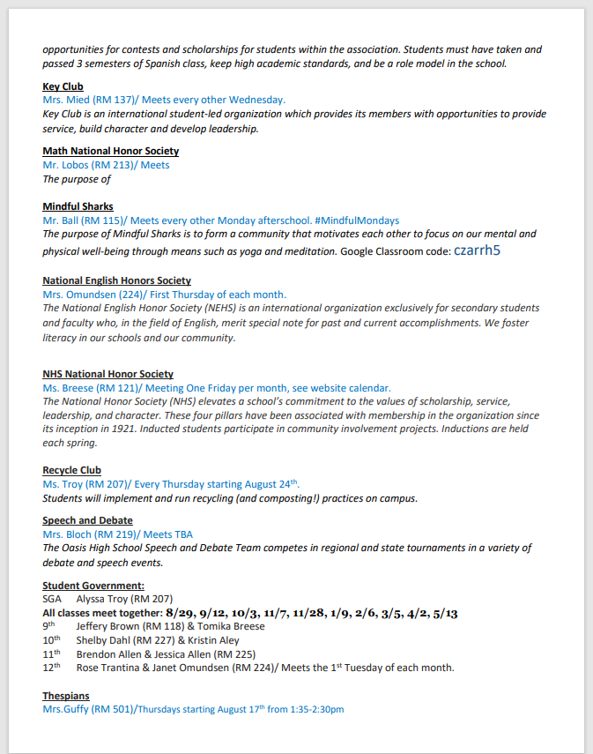

Clubs

Slide 8
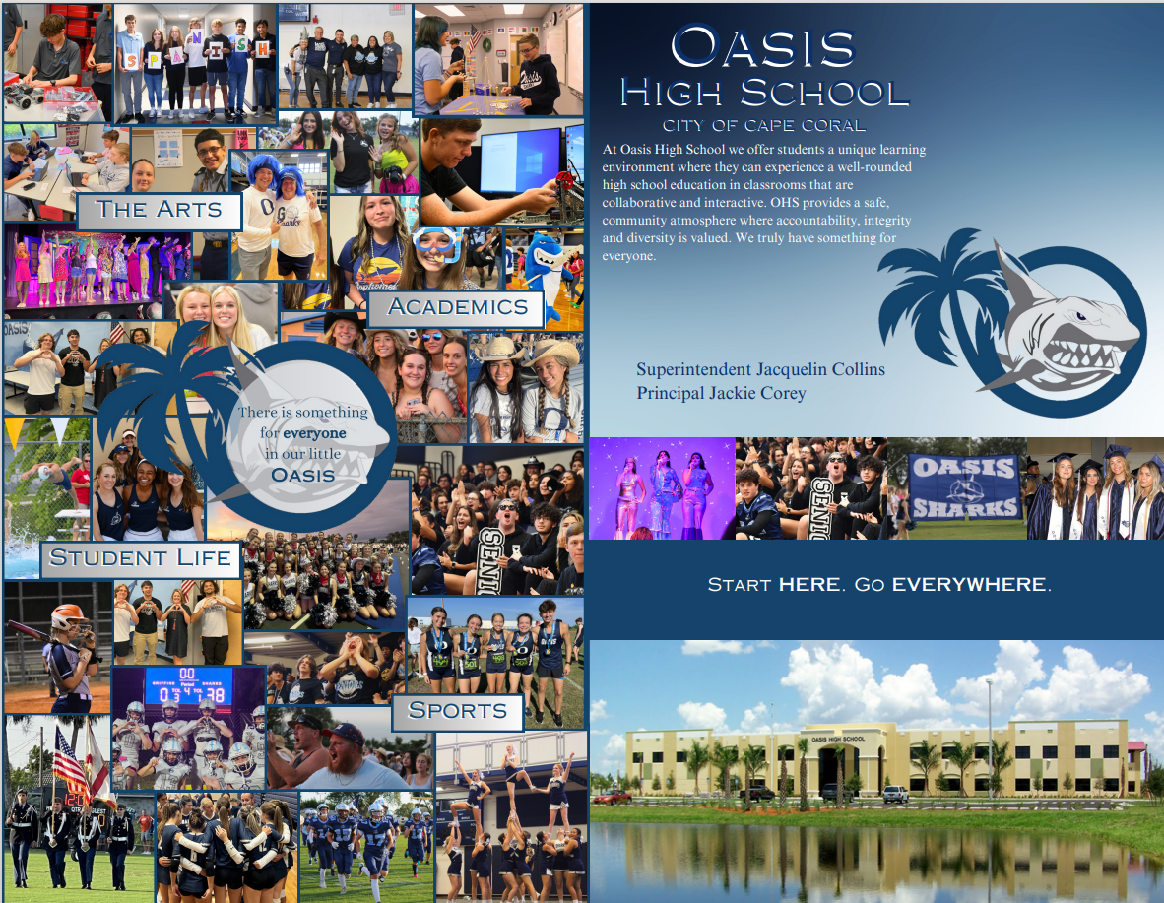
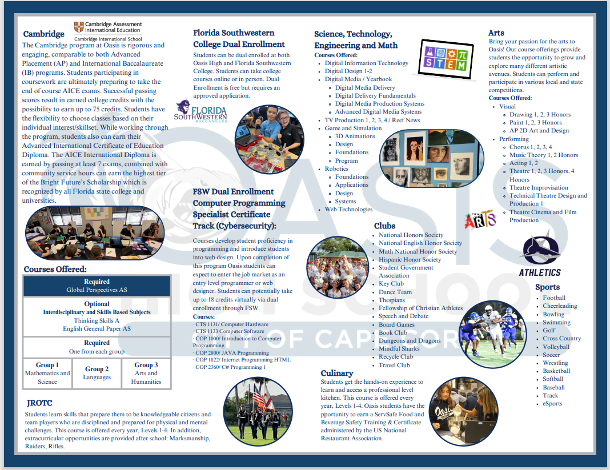
School Brochure
Ms. Kray
Digital Media

Slide 9
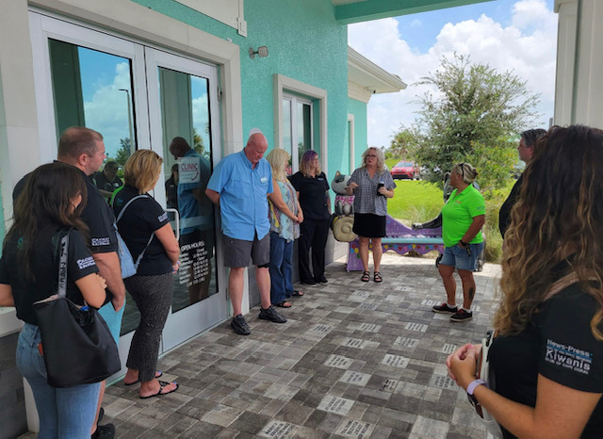

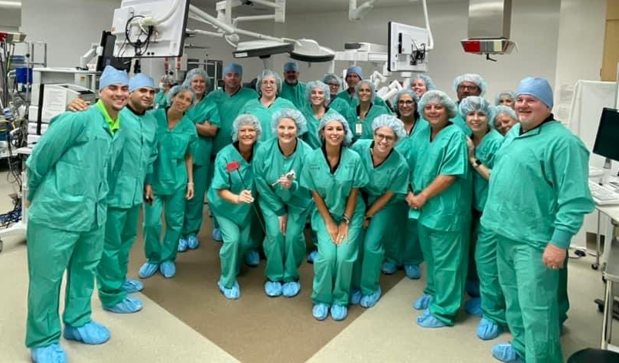
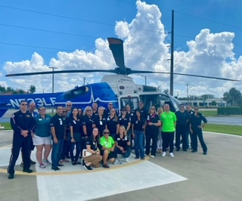
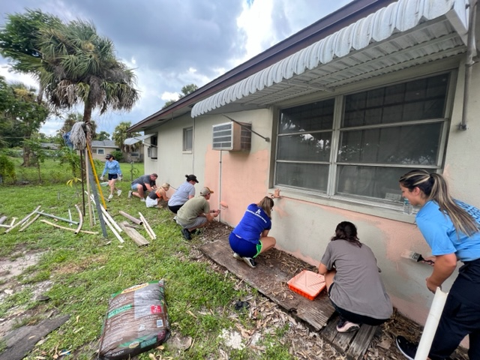
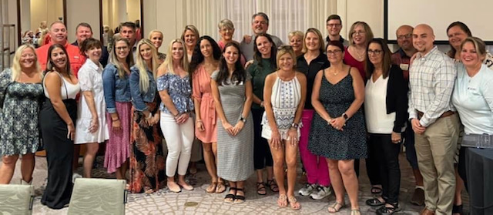
Leadership Cape Coral

Slide 10
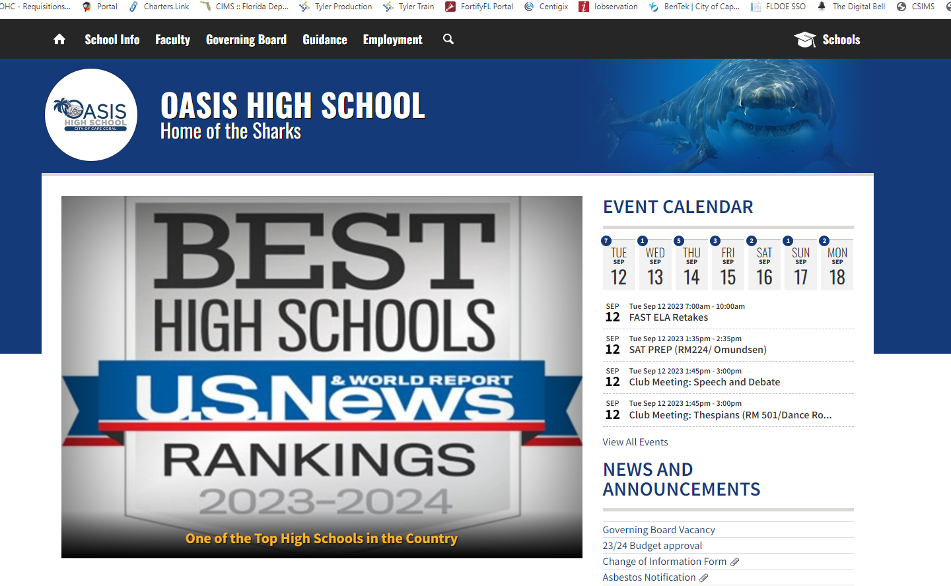
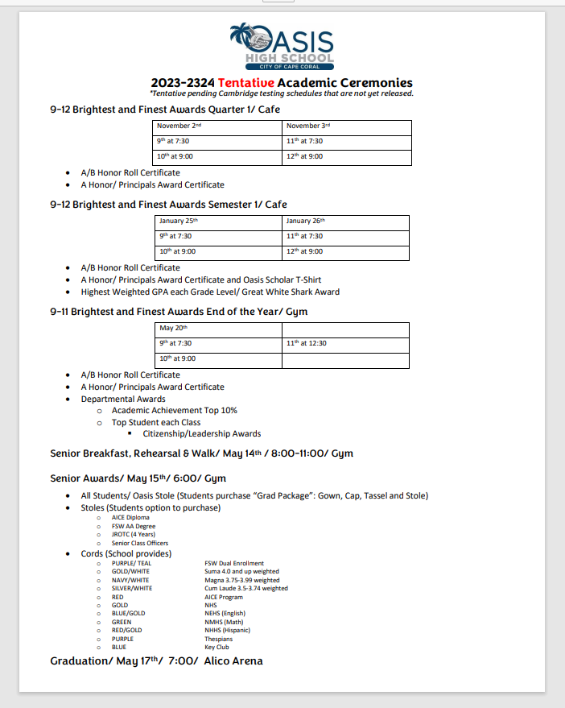

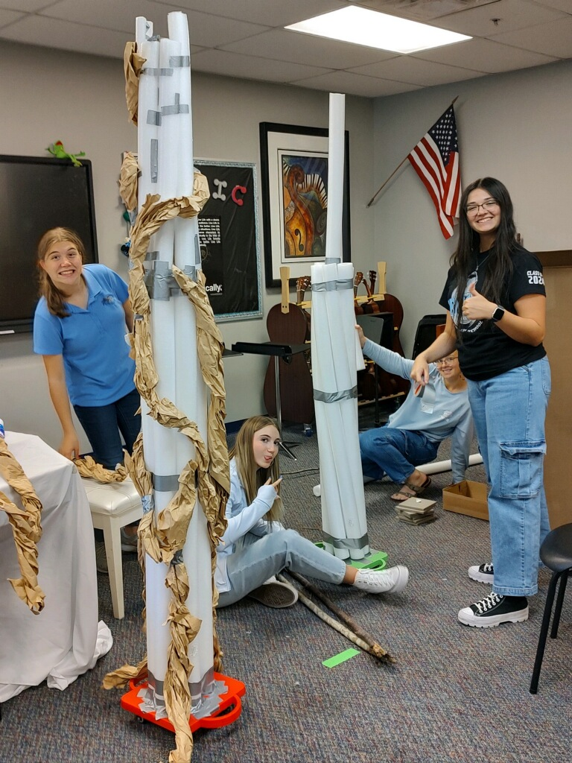


Coming Soon…
Quarterly Newsletter

Slide 11

State of Our School…
Grade | Cambridge | General | Total
9th | 102/ 46% | 120 | 222
10th | 101/ 53% | 90 | 191
11th | 97/ 43% | 127 | 224
12th | 63/ 39% | 100 | 163
Total | 363/ 45% | 437 | 804

Slide 12


School Name | Number of Students | Mean Scale Score | Percentage in Level 3 or Above
U.S. HISTORY EOC STATE TOTALS | 189,980 | 405 | 63
OASIS CHARTER HIGH SCHOOL | 161 | 408 | 73
FORT MYERS HIGH SCHOOL | 457 | 413 | 71
NORTH FORT MYERS HIGH SCHOOL | 383 | 411 | 71
CAPE CORAL HIGH SCHOOL | 384 | 407 | 64
RIVERDALE HIGH SCHOOL | 418 | 402 | 61
CYPRESS LAKE HIGH SCHOOL | 362 | 404 | 60
ESTERO HIGH SCHOOL | 322 | 401 | 60
GATEWAY HIGH SCHOOL | 553 | 401 | 60
IDA S. BAKER HIGH SCHOOL | 404 | 400 | 58
LEHIGH SENIOR HIGH SCHOOL | 508 | 398 | 56
BONITA SPRINGS HIGH SCHOOL | 371 | 397 | 55
GATEWAY CHARTER HIGH SCHOOL | 105 | 395 | 48
MARINER HIGH SCHOOL | 399 | 391 | 47
ISLAND COAST HIGH SCHOOL | 316 | 388 | 42
EAST LEE COUNTY HIGH SCHOOL | 386 | 387 | 42
SOUTH FORT MYERS HIGH SCHOOL | 436 | 384 | 35
DUNBAR HIGH SCHOOL | 408 | 384 | 35
ISLAND PARK HIGH SCHOOL | 62 | 377 | 31

Slide 13

School Name | Number of Students | Mean Scale Score | Percentage in Level 3 or Above
BIOLOGY 1 EOC STATE TOTALS | 215,288 | 403 | 63
BONITA SPRINGS CHARTER SCHOOL | 56 | 423 | 95
FLORIDA SOUTHWESTERN COLLEGIATE HIGH SCHOOL | 85 | 429 | 94
MID CAPE GLOBAL ACADEMY | 31 | 411 | 77
SIX MILE CHARTER ACADEMY | 30 | 412 | 77
OASIS CHARTER HIGH SCHOOL | 211 | 408 | 74
NORTH FORT MYERS HIGH SCHOOL | 489 | 409 | 72
FORT MYERS HIGH SCHOOL | 437 | 407 | 71
ESTERO HIGH SCHOOL | 305 | 402 | 63
GATEWAY HIGH SCHOOL | 554 | 403 | 62
RIVERDALE HIGH SCHOOL | 422 | 398 | 60
IDA S. BAKER HIGH SCHOOL | 508 | 399 | 58
BONITA SPRINGS HIGH SCHOOL | 326 | 396 | 56
GATEWAY CHARTER HIGH SCHOOL | 107 | 393 | 51
CAPE CORAL HIGH SCHOOL | 631 | 393 | 48
MARINER HIGH SCHOOL | 618 | 389 | 45
CYPRESS LAKE HIGH SCHOOL | 533 | 388 | 42
SOUTH FORT MYERS HIGH SCHOOL | 457 | 386 | 40
EAST LEE COUNTY HIGH SCHOOL | 491 | 385 | 40
LEHIGH SENIOR HIGH SCHOOL | 639 | 386 | 38
ISLAND COAST HIGH SCHOOL | 454 | 384 | 37
DUNBAR HIGH SCHOOL | 719 | 378 | 28
ISLAND PARK HIGH SCHOOL | 25 | 364 | 8
NORTH NICHOLAS HIGH SCHOOL | 13 | 351 | 0

Slide 14

School Name | Grade | Number of Students | Mean Scale Score | Percentage in Level 3 or Above
FLORIDA SOUTHWESTERN COLLEGIATE HIGH SCHOOL | 9 | 94 | 362 | 85
OASIS CHARTER HIGH SCHOOL | 9 | 196 | 349 | 66
NORTH FORT MYERS HIGH SCHOOL | 9 | 484 | 349 | 63
FORT MYERS HIGH SCHOOL | 9 | 450 | 344 | 59
CAPE CORAL HIGH SCHOOL | 9 | 480 | 343 | 55
ESTERO HIGH SCHOOL | 9 | 377 | 342 | 55
BONITA SPRINGS HIGH SCHOOL | 9 | 372 | 342 | 52
GATEWAY HIGH SCHOOL | 9 | 640 | 340 | 51
CYPRESS LAKE HIGH SCHOOL | 9 | 346 | 337 | 48
RIVERDALE HIGH SCHOOL | 9 | 379 | 337 | 48
IDA S. BAKER HIGH SCHOOL | 9 | 471 | 337 | 48
GATEWAY CHARTER HIGH SCHOOL | 9 | 186 | 337 | 44
MARINER HIGH SCHOOL | 9 | 493 | 335 | 42
LEHIGH SENIOR HIGH SCHOOL | 9 | 592 | 333 | 39
SOUTH FORT MYERS HIGH SCHOOL | 9 | 456 | 330 | 34
EAST LEE COUNTY HIGH SCHOOL | 9 | 510 | 327 | 30
DUNBAR HIGH SCHOOL | 9 | 483 | 326 | 30
ISLAND COAST HIGH SCHOOL | 9 | 404 | 324 | 27
ISLAND PARK HIGH SCHOOL | 9 | 21 | 311 | 5
ELA 9th

Slide 15
School Name | Grade | Number of Students | Mean Scale Score | Percentage in Level 3 or Above
GRADE 10 | 10 | 213,323 | 346 | 50
FLORIDA SOUTHWESTERN COLLEGIATE HIGH SCHOOL | 10 | 95 | 366 | 83
NORTH FORT MYERS HIGH SCHOOL | 10 | 450 | 357 | 65
FORT MYERS HIGH SCHOOL | 10 | 465 | 354 | 62
OASIS CHARTER HIGH SCHOOL | 10 | 224 | 351 | 57
CYPRESS LAKE HIGH SCHOOL | 10 | 389 | 343 | 51
CAPE CORAL HIGH SCHOOL | 10 | 469 | 348 | 51
ESTERO HIGH SCHOOL | 10 | 345 | 345 | 50
RIVERDALE HIGH SCHOOL | 10 | 464 | 346 | 49
GATEWAY HIGH SCHOOL | 10 | 633 | 343 | 48
IDA S. BAKER HIGH SCHOOL | 10 | 489 | 343 | 47
GATEWAY CHARTER HIGH SCHOOL | 10 | 151 | 344 | 47
BONITA SPRINGS HIGH SCHOOL | 10 | 356 | 344 | 46
MARINER HIGH SCHOOL | 10 | 468 | 340 | 42
LEHIGH SENIOR HIGH SCHOOL | 10 | 534 | 341 | 40
EAST LEE COUNTY HIGH SCHOOL | 10 | 457 | 334 | 32
DUNBAR HIGH SCHOOL | 10 | 429 | 331 | 31
SOUTH FORT MYERS HIGH SCHOOL | 10 | 368 | 331 | 30
ISLAND COAST HIGH SCHOOL | 10 | 394 | 332 | 28
ISLAND PARK HIGH SCHOOL | 10 | 41 | 314 | 12
ELA 10th

Slide 16

School Name | Number of Students | Mean Scale Score | Percentage in Level 3 or Above
B.E.S.T. ALGEBRA 1 EOC STATE TOTALS | 220,411 | 497 | 54
MID CAPE GLOBAL ACADEMY | 50 | 531 | 98
ATHENIAN ACADEMY CHARTER SCHOOL | 26 | 518 | 96
OAK CREEK CHARTER SCHOOL OF BONITA SPRINGS | 19 | 518 | 89
BONITA SPRINGS CHARTER SCHOOL | 104 | 519 | 87
FLORIDA SOUTHWESTERN COLLEGIATE HIGH SCHOOL | 17 | 501 | 71
SIX MILE CHARTER ACADEMY | 50 | 505 | 70
OASIS CHARTER HIGH SCHOOL | 111 | 490 | 40
NORTH FORT MYERS HIGH SCHOOL | 186 | 481 | 30
ISLAND COAST HIGH SCHOOL | 327 | 473 | 25
ESTERO HIGH SCHOOL | 189 | 476 | 25
RIVERDALE HIGH SCHOOL | 206 | 475 | 24
BONITA SPRINGS HIGH SCHOOL | 200 | 474 | 24
IDA S. BAKER HIGH SCHOOL | 269 | 476 | 24
FORT MYERS HIGH SCHOOL | 211 | 477 | 22
SOUTH FORT MYERS HIGH SCHOOL | 363 | 473 | 22
CAPE CORAL HIGH SCHOOL | 273 | 475 | 22
GATEWAY HIGH SCHOOL | 404 | 474 | 21
LEHIGH SENIOR HIGH SCHOOL | 432 | 473 | 19
GATEWAY CHARTER HIGH SCHOOL | 136 | 478 | 18
CORONADO HIGH SCHOOL | 12 | 470 | 17
DUNBAR HIGH SCHOOL | 358 | 465 | 16
CYPRESS LAKE HIGH SCHOOL | 241 | 467 | 15
MARINER HIGH SCHOOL | 348 | 471 | 14
EAST LEE COUNTY HIGH SCHOOL | 419 | 466 | 11
ISLAND PARK HIGH SCHOOL | 17 | 451 | 6

Slide 17

School Name | Number of Students | Mean Scale Score | Percentage in Level 3 or Above
B.E.S.T. GEOMETRY EOC STATE TOTALS | 215,342 | 495 | 49
BONITA SPRINGS CHARTER SCHOOL | 24 | 538 | 100
SIX MILE CHARTER ACADEMY | 15 | 527 | 100
FLORIDA SOUTHWESTERN COLLEGIATE HIGH SCHOOL | 91 | 519 | 87
OASIS CHARTER HIGH SCHOOL | 205 | 509 | 74
NORTH FORT MYERS HIGH SCHOOL | 456 | 505 | 65
FORT MYERS HIGH SCHOOL | 387 | 496 | 57
CAPE CORAL HIGH SCHOOL | 476 | 497 | 57
IDA S. BAKER HIGH SCHOOL | 534 | 495 | 52
BONITA SPRINGS HIGH SCHOOL | 354 | 492 | 49
ESTERO HIGH SCHOOL | 376 | 492 | 48
MARINER HIGH SCHOOL | 527 | 487 | 42
GATEWAY HIGH SCHOOL | 620 | 491 | 42
CYPRESS LAKE HIGH SCHOOL | 396 | 487 | 41
GATEWAY CHARTER HIGH SCHOOL | 141 | 490 | 40
LEHIGH SENIOR HIGH SCHOOL | 526 | 485 | 36
RIVERDALE HIGH SCHOOL | 417 | 486 | 35
SOUTH FORT MYERS HIGH SCHOOL | 425 | 481 | 34
DUNBAR HIGH SCHOOL | 434 | 483 | 33
ISLAND COAST HIGH SCHOOL | 418 | 477 | 30
EAST LEE COUNTY HIGH SCHOOL | 476 | 476 | 23
CORONADO HIGH SCHOOL | 13 | 474 | 8
ISLAND PARK HIGH SCHOOL | 36 | 461 | 3

Slide 18

Graduation rate
Currently At Risk
21 Students
We will work as a TEAM to support coach and motivate these students.
Teachers will be emailed this effects.

Slide 19



Celebrations
Schedule for the year…

Slide 20

What's Happening?
Up to date information at your fingertips!

Slide 21




Quarterly Newsletter Coming Soon
Tell our story…
Communicate Information…
Coming out end of Quarter 1!

Slide 22



Oasis High School
October 13th
^{Gym Lobby}
Instant Decision Day
Apply FREE
Get accepted immediately!
Coming Soon…

Slide 23

Hurricane Make-up Days
December 21 and 22 are FULL DAYS

Slide 24

Foundations News…

Slide 25

Coming soon…

